Slide 1
Network Cable Types
This tutorial explains the types of network cables used in computer networks in detail. Learn the specifications, standards, and features of the coaxial cable, twisted-pair cable, and fiber-optical cable.
To connect two or more computers or networking devices in a network, network cables are used. There are three types of network cables; coaxial, twisted-pair, and fiber-optic.

Slide 2
Coaxial cable
This cable contains a conductor, insulator, braiding, and sheath. The sheath covers the braiding, the braiding covers the insulation, and the insulation covers the conductor.

Slide 3
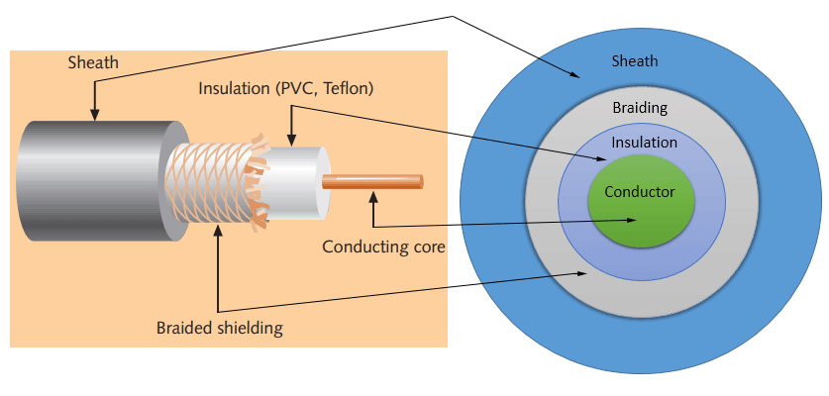
The following image shows these components.

Slide 4
Sheath
This is the outer layer of the coaxial cable. It protects the cable from physical damage.
Braided shield
This shield protects signals from external interference and noise. This shield is built from the same metal that is used to build the core.
Insulation
Insulation protects the core. It also keeps the core separate from the braided shield. Since both the core and the braided shield use the same metal, without this layer, they will touch each other and create a short-circuit in the wire.
Conductor
The conductor carries electromagnetic signals. Based on conductor a coaxial cable can be categorized into two types; single-core coaxial cable and multi-core coaxial cable.

Slide 5
Coaxial cables in computer networks
The coaxial cables were not primarily developed for the computer network. These cables were developed for general purposes. They were in use even before computer networks came into existence. They are still used even their use in computer networks has been completely discontinued.
At the beginning of computer networking, when there were no dedicated media cables available for computer networks, network administrators began using coaxial cables to build computer networks.

Slide 6
Twisted-pair cables
The twisted-pair cable was primarily developed for computer networks. This cable is also known as Ethernet cable. Almost all modern LAN computer networks use this cable.
This cable consists of color-coded pairs of insulated copper wires. Every two wires are twisted around each other to form pair. Usually, there are four pairs. Each pair has one solid color and one stripped color wire. Solid colors are blue, brown, green, and orange. In stripped color, the solid color is mixed with the white color.

Slide 7
Based on how pairs are stripped in the plastic sheath, there are two types of twisted-pair cable; UTP and STP.
In the UTP (Unshielded twisted-pair) cable, all pairs are wrapped in a single plastic sheath.
In the STP (Shielded twisted-pair) cable, each pair is wrapped with an additional metal shield, then all pairs are wrapped in a single outer plastic sheath.

Slide 8
Fiber optic cable
This cable consists of a core, cladding, buffer, and jacket. The core is made from thin strands of glass or plastic that can carry data over a long distance. The core is wrapped in the cladding; the cladding is wrapped in the buffer, and the buffer is wrapped in the jacket.
Core carries the data signals in the form of light.
Cladding reflects light back to the core.
Buffer protects the light from leaking.
The jacket protects the cable from physical damage.

Slide 9
Fiber optic cable is completely immune to EMI and RFI. This cable can transmit data over a long distance at the highest speed. It can transmit data up to 40 kilometers at the speed of 100Gbps. Fiber optic uses light to send data. It reflects light from one endpoint to another. Based on how many beams of light are transmitted at a given time, there are two types of fiber optical cable; SMF and MMF.

Slide 10
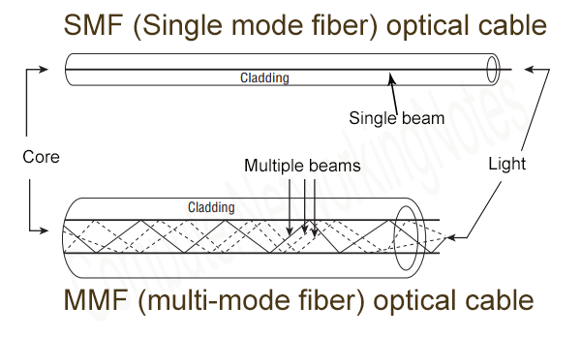

Slide 11
SMF (Single-mode fiber) optical cable
MMF (multi-mode fiber) optical cable
SMF (Single-mode fiber) optical cable
This cable carries only a single beam of light. This is more reliable and supports much higher bandwidth and longer distances than the MMF cable. This cable uses a laser as the light source and transmits 1300 or 1550 nano-meter wavelengths of light.
This cable carries multiple beams of light. Because of multiple beams, this cable carries much more data than the SMF cable. This cable is used for shorter distances. This cable uses an LED as the light source and transmits 850 or 1300 nano-meter wavelengths of light.

